Slide 1
CUDA Optimizations
Farzon Lotfi
&
Arin Baris

Slide 2
Development platforms
Intel Core 2 Quad 3.0 Ghz with an Nvidia GeForce 8800 GT 512MB (Linux OS)
Core: frequency: 1.65 GHz, Mem frequency: 950 MHz
Intel Core 2 Duo 2.53 Ghz with an Nvidia GeForce 9400M (Mac OS)
AMD Phenom 9950 2.6 Ghz Nvida GTS 450
Core: frequency: 783 Mhz, Mem frequency 3.6 Ghz
Intel Core 2 Dup 2.20 Ghz with an Nvidia 9500M
Core: frequency: 625 Mhz , Mem frequency 1.6 Ghz

Slide 3
CuDA Optimization Techniques
Block size manipulation
found a 16x16 block to be fastest 8x8 was a close second
Added Shared Memory
Added Loop unrolling
Fastest when you only unroll a fourth to a half of the loop (data on preceding slides does not account for this)

Slide 4
Matrix multiplication 1/4
Benchmark ran on Core 2 Quad with 8800 GT. CUDA compared against OpenMP and Ptheads each using 4 threads
OPenMP Optimizations:
Used the rule of N Threads on a N CPU machine
Loop level parallelism to cut the process time of a loop of m elements by N threads i.e. (m/N)
Threads share row iterations according to a predefined chunk size.
Thread safe use of shared and private memory
Static scheduling of threads to remove the cost of dynamic scheduling (benchmarks run with out the variable of other user programs running).

Slide 5
Matrix Multiplication 2/4
Compiler optimizations:
O2 and O3 compiler optimizations
-mach gcc flag for architecture based optimizations
-use_fast_math (speedup for floating point arithmetic)

Slide 6
Matrix Multiplication 3/4
The Data
The time is represented in seconds and shows the averages over three runs of the most optimized versions of the algorithm
Edge length of square matrix | SEQ avg | Pthread avg | OpenMP avg | CUDA avg
100 | 0.001364 | 0.000704333 | 0.000747 | 0.043054333
200 | 0.010089333 | 0.003128333 | 0.004182667 | 0.044102667
300 | 0.031604667 | 0.012004667 | 0.010698333 | 0.047264333
400 | 0.072319 | 0.024801667 | 0.023449667 | 0.046442333
500 | 0.162871333 | 0.051245333 | 0.049393667 | 0.059222667
600 | 0.568023333 | 0.164804667 | 0.179456333 | 0.060988
700 | 1.026019333 | 0.279560333 | 0.283793 | 0.082562333
800 | 1.619929667 | 0.427156333 | 0.430608 | 0.066677667
900 | 2.991015667 | 0.789544667 | 0.798438 | 0.130003
1000 | 4.487729 | 1.161472667 | 1.160349667 | 0.124985
Data shows the Speed up of the graphs of the previous slides
Edge length of square matrix | avg Pthread speedup | avg OpenMP speedup | CUDA Speedup
100 | 1.936583057 | 1.825970549 | 0.031680899
200 | 3.22514651 | 2.412177239 | 0.228769235
300 | 2.632698395 | 2.954167316 | 0.66867899
400 | 2.915892749 | 3.084009723 | 1.557178436
500 | 3.178266639 | 3.297413299 | 2.750151969
600 | 3.446645928 | 3.165245399 | 9.313690125
700 | 3.670117721 | 3.615379285 | 12.42720853
800 | 3.792357833 | 3.761959059 | 24.29493634
900 | 3.788279236 | 3.746083812 | 23.00728188
1000 | 3.863826613 | 3.86756607 | 35.90614074

Slide 7
Matrix Multiply 4/4
Analysis of the Data
The striking thing I notices is that it takes a matrix size of 300x300 before we start to see speed up gains faster than the CPU and a matrix size of 600x600 for it to be faster than other forms of parallelism
My conclusion is that the speed-up in computation does not overcome the overhead of copying data to and from the device coupled with loading the kernel binary to the device
Furthermore There is a large limiting factor on the speedup on threading for the CPU. At best I could only see a speedup just under 4x for a quad core machine. My conclusion is that speedup vs. sequential algorithms on the CPU will always be less than the number of cores because of OS level processes and Cache misses.

Slide 8
Block Matrix Multiply on FERMI

Slide 9
Single Precision G80

Slide 10
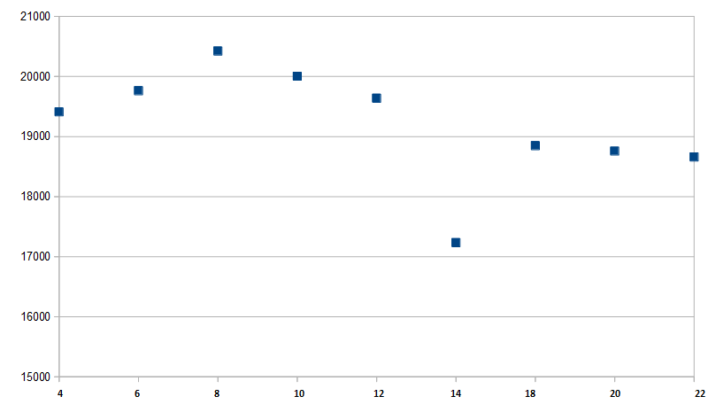
A Single Point

Slide 11
Double Precision G80

Slide 12
A Single Point (300)

Slide 13
Fermi Single Precision

Slide 14
Fermi Double Precision

Slide 15
Matrix Demo

Slide 16
Convolution Small Input

Slide 17
Convolution Large Input

